Slide 1
TECHNICAL UNIVERSITY OF KENYA A GIS Application in Competency-Based Curriculum Schools Accessibility Mapping and Proposing Future Secondary Schools Locations: Case Study of Makadara Sub-County. By Theresa Nyatichi Monari ESSI/01552/2018 March, 2023 Supervisor: Mr. Tom Mumo

Slide 2
Presentation Outline
Introduction
Problem Statement
Area of Study
Objectives
Methodology
Results and Discussion
Conclusion and Recommendations

Slide 3
Introduction
The Kenyan Constitution from 2010 identifies education as a guaranteed right to every Kenyan.
In 2017, KICD introduced the CBC which targets to be a more student-based system.
The Distribution of CBC schools centers has not been carried effectively to meet the demographic demands.
GIS is a powerful tool for developing and planning spatial events because they are designed to capture, handle, analyze, manage, store, and display geographical data.

Slide 4
Problem Statement
Makadara sub-county has 51 primary schools, and 15 secondary schools.
The research problem is thus to determine the relationship between schools distribution in the area, physical accessibility, and school enrolment.
As a result, GIS will be used to analyze the distribution of schools, identify disparities in the CBC school’s location accessibility, and propose future areas for secondary schools based on suitability analysis.

Slide 5
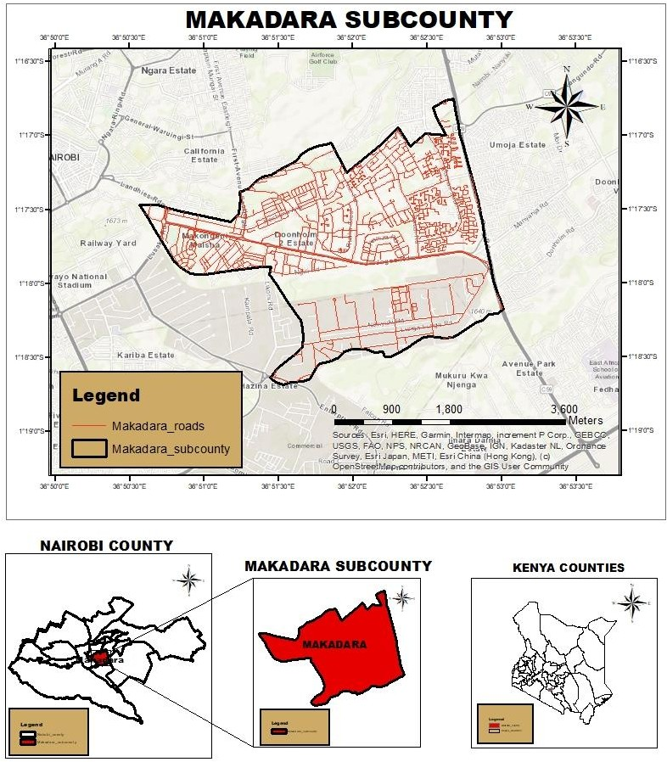
Area of Study

Slide 6
Objectives
Main Objective
The main objective of this project is to show the use of GIS in mapping out the distribution of primary and secondary schools in Makadara Sub-county.
Specific Objectives
To collect spatial data on the schools and roads in the Makadara sub-county.
To identify the existing disparities in the distribution of CBC schools, and determine their proximity and accessibility in Makadara sub-county
To carry out a suitability analysis to determine and propose the locations of new CBC secondary schools in the future.

Slide 7
Methodology

Slide 8
Results and Discussion
The distribution of Primary schools in Makadara sub-county.

Slide 9
ii) CBC school’s enrollment to population

Slide 10
iii) Proximity Analysis(Near analysis of roads and schools)

Slide 11
iv) Primary schools catchment areas in Makadara Sub-county

Slide 12
v) Proposed CBC (Primary) Schools

Slide 13
vi) Distribution of secondary schools in Makadara sub-county

Slide 14
vii) Proposed secondary schools

Slide 15
Conclusion
Access to education as indicated by school enrolments has a direct relationship with the population’s physical access as measured by the proximity of schools to roads.
Increasing the number of schools and improving the condition of roads will increase the chances of school children accessing education.

Slide 16
Recommendations
Road network accessibility can be enhanced to increase the accessibility of schools. The road network is a key factor to evaluate the accessibility of schools and therefore reconnaissance of physical access is important before the establishment of the institutions
The implementation of the proposed schools if well done is an assurance that the schools will be almost evenly distributed within the area’s population to ensure that efficient and quality education is delivered.

